Slide 1
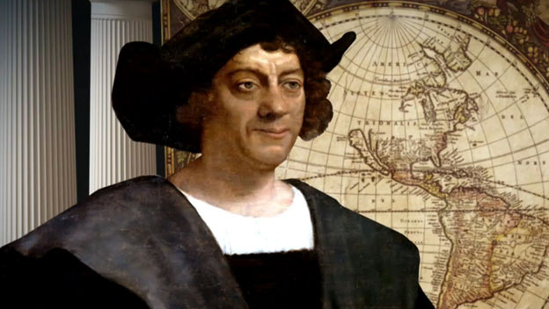
การค้นพบทวีปอเมริกา
(the Discovery of America)
โดย Woraporn Promjairak

Slide 2
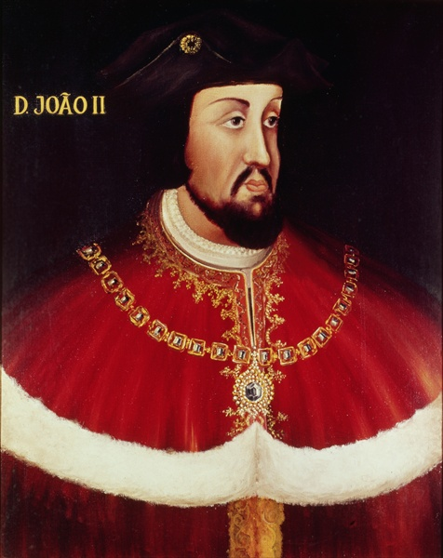
Christopher Columbus
Columbus was born in Genoa, Italy, in 1451.
He worked as a seaman and then a maritime entrepreneur.
With only the Atlantic Ocean, he thought, lying between Europe and the riches of the East Indies, Columbus met with King John II of Portugal and tried to persuade him to back his “Enterprise of the Indies,” as he called his plan.
King John ii of Portugal (1481-1495)

Slide 3
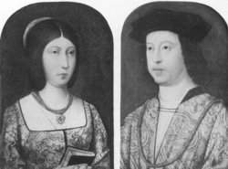
King Ferdinand and Queen Isabella
Queen Isabella of Castile and King Ferdinand of Aragon

Slide 4
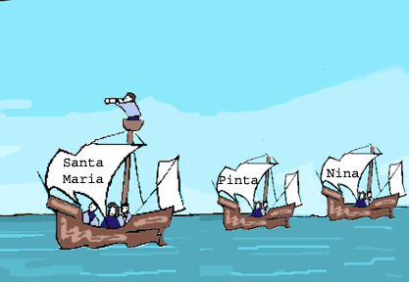
The Exploration
On August 3, 1492, Columbus set sail from Palos, Spain, with three small ships, the Santa Maria, the Pinta,
and the Nina.

Slide 5
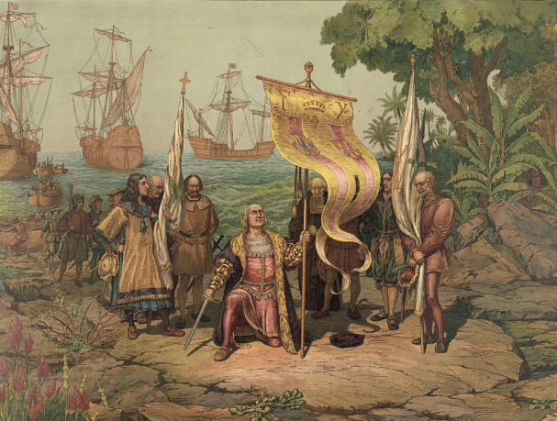
The Columbus Day
Early on the morning of October 12th land was indeed sighted, and a landing party arrived on an island in the Bahamas and named it San Salvador. The natives must have been surprised to hear that their island now belonged to Spain.

Slide 6
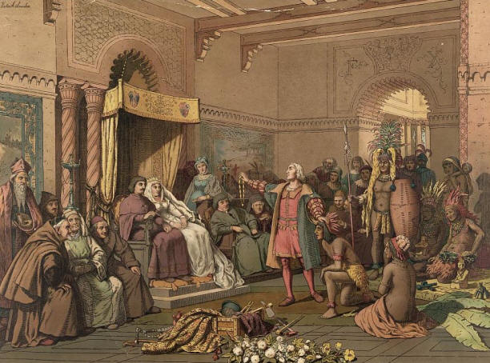
COLUMBUS RETURNED TO SPAIN.
On Friday, March 15,1493, Christopher Columbus went back to Spain and presented the Indians and other treasures from the World to Queen Isabella and King Ferdinand.

Slide 7
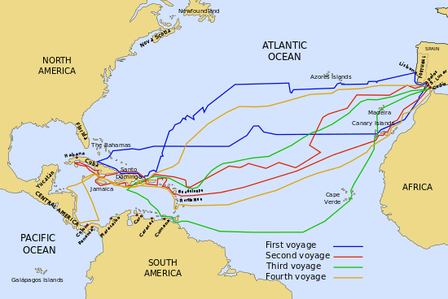
The Voyage of Christopher Columbus

